Slide 1
Collaboration in telemedicine
Stine Hangaard Casper
Associate Professor

Slide 2
STINE HANGAARD CASPER
Associate Professor at Aalborg University, Medical Informatics
Researcher at Steno Diabetes Center North Denmark, Research and Digital Health and Diabetes
Medvejleder på ny uddannelse i Helseinformatik på Universitetet i Tromsø

Slide 3
Agenda:
Medical Informatics Research Group
Telemonitoring trial in diabetes
Clinical Implementation of an algoritm in TeleCare North

Slide 4
Medical Informatics group
Digital health - main focus explainable AI and telemedicine & telecare
Scientific staff of 24 people
Multidisciplinary team
Engineering
Clinical science and technology
Nursing
Medicine
Economy
Public health
Physiotherapy
Occupational therapy
Midwifery
Bioanalytics

Slide 5
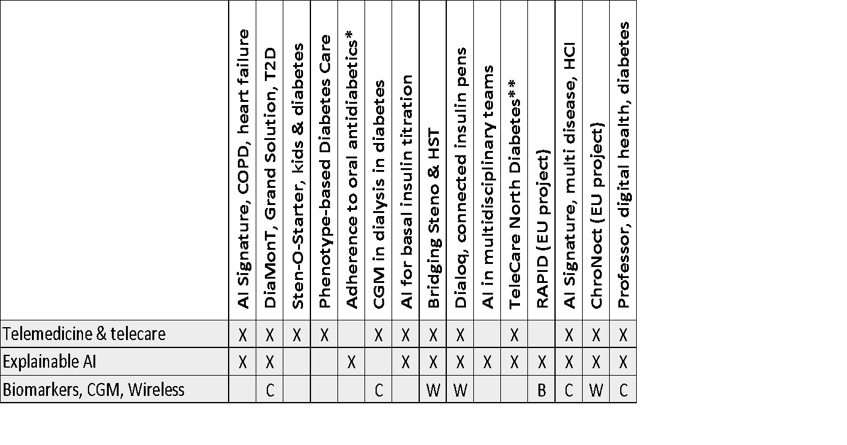

Slide 7
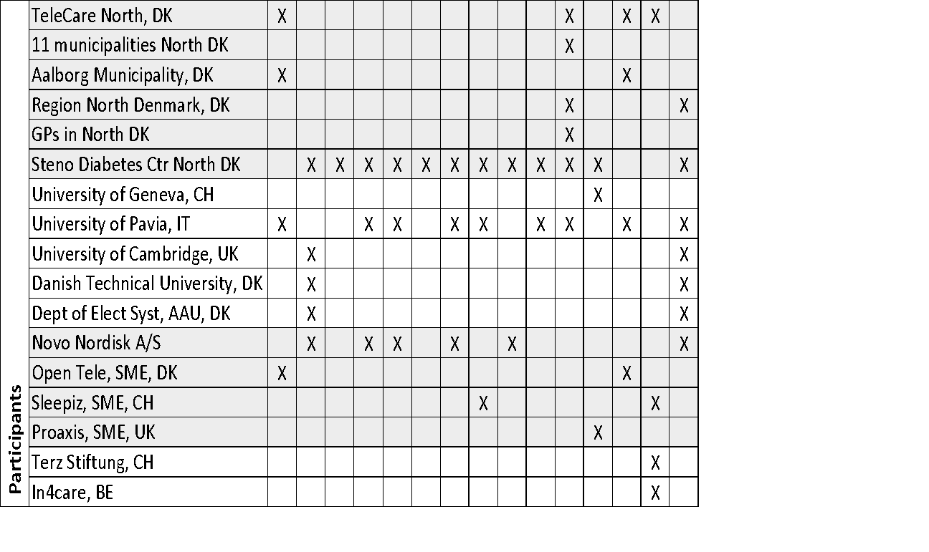

Slide 8
THE DIAMONT TRIAL

Slide 9
Project plan – adapt-t2d
WP1
WP2
WP3
WP4
WP5
Data collection toolbox
Collect data
(obs. study & existing databases)
Big data high fidelity T2 model
Dose guidance algorithms
Clinical feasibility testing
Project organisation and management
WP0
Notes:
Efficiency and implementation (e.g. project plan, organisation, budget, IP, risk)

Slide 10
ADAPT-T2D Partners
Steno Diabetets Center North Denmark
Steno Diabetets Center Zealand
Novo Nordisk
AAU – ES &HST
DTU
Glooko
Notes:
Efficiency and implementation (e.g. project plan, organisation, budget, IP, risk)

Slide 11
Background
The effect of telemedicine solutions in diabetes remains inconclusive. However, telemedicine studies have shown a positive trend in regards to glycemic control.
It is recommended that future telemedicine studies for patients with diabetes include patient-specific suggestions for changes in medicine.

Slide 12
Trial objectives
The primary objective: To explore the effect of a telemonitoring intervention
The secondary objective: To collect data for the development of algorithms for dose guidance as well as for the prediction of adverse events

Slide 13
Trial design
Open-label randomized controlled trial
Trial period: Three months
Patients with T2D in insulin therapy
Telemonitoring (intervention) is compared to usual care (control).
Notes:
The design is an open-label randomized controlled trial with a trial period of three months. Patients with T2D in telemonitoring (intervention) are compared with patients with T2D in usual care (control).

Slide 14
Selection of subjects
Inclusion criteria
Exclusion trial
Women and men ≥ 18 years
T2D diagnosis for ≥12 months
Residence in Region North Denmark or Region Zealand
In treatment with Novo Nordisk insulin
Being able to use a smartphone + other trial devises
Being able to understand and read Danish
Pregnancy or breastfeeding
Major surgery planned during the trial period
Participation in other trials
Terms that, in the opinion of the subinvestigator or investigator, render the subject unfit to conduct the trial
Notes:
. Here you see the inclusion and exclusion criteria for the trial. They will all be patients with type 2 diabetes who are already treated with insulin. The participants in the trial must be treated with insulin products from Novo Nordisk A/S, we do not wish to change the patients treatment. Maybe I should also highlight the inclusion criteria that dictate that patients must be able to use the devises that are nessessary for the trial.
Terms that: including lack of understanding of the trial or lack of physical or cognitive ability to participate.

Slide 15
Study sites
Steno Diabetes Center North Jutland
Steno Diabetes Center Zealand
Aalborg University Hospital
300 patients
Nykøbing Falster Hospital
100 patients

Slide 16
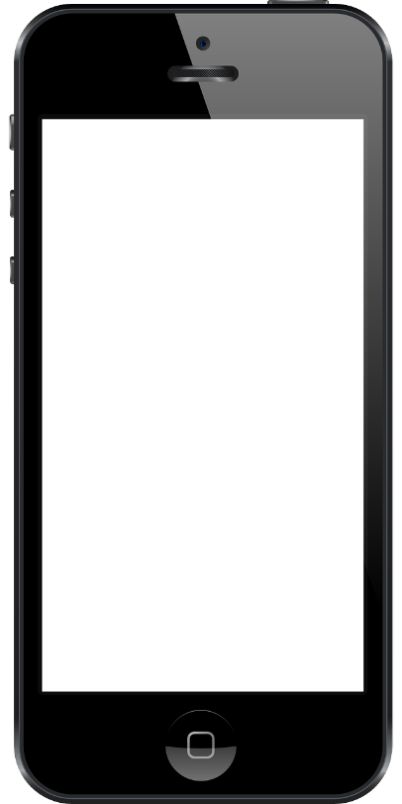
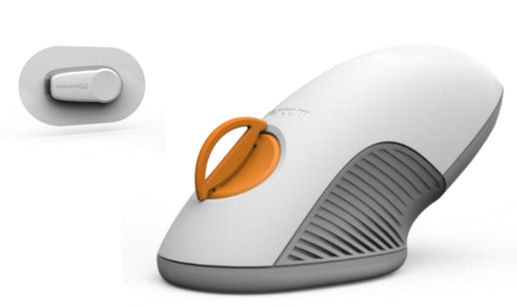
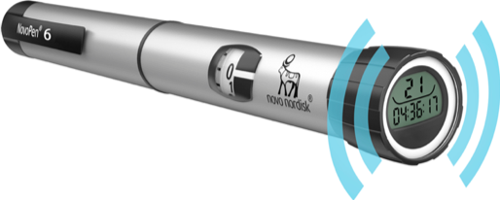
Devices
Notes:
Fitbit vharge 4
Novopen 6
Dexcom G6
Android/apple SF
Skift af insulin til Tresiba, indkøb af hurtigtvirkende
Lånetelefoner
Apps: Fitbit, dexcom, diasend

Slide 17
The telemonitoring group
1. Endocrinology outpatient clinic visit
Telemonitoring at home (3 months)
2. Endocrinology outpatient clinic visit
Blood sample
Demographics
Introduction to technology
Questionnaires
The participant measures at home
Monitoring if needed + calls after 1 week, 1 month and 2 months.
Blood sample
Questionnaires
Return devices
Notes:
Skifter selv sensor

Slide 18
The control group
1. Endocrinology outpatient clinic visit
Telemonitoring at home (3 months)
2. Endocrinology outpatient clinic visit
Blood sample
Demographics
Introduction to technology
Questionnaires
Participant continues current treatment with blinded devices (CGM first and last 20 days)
Blood sample
Questionnaires
Return devices
Notes:
Skifter selv sensor

Slide 19
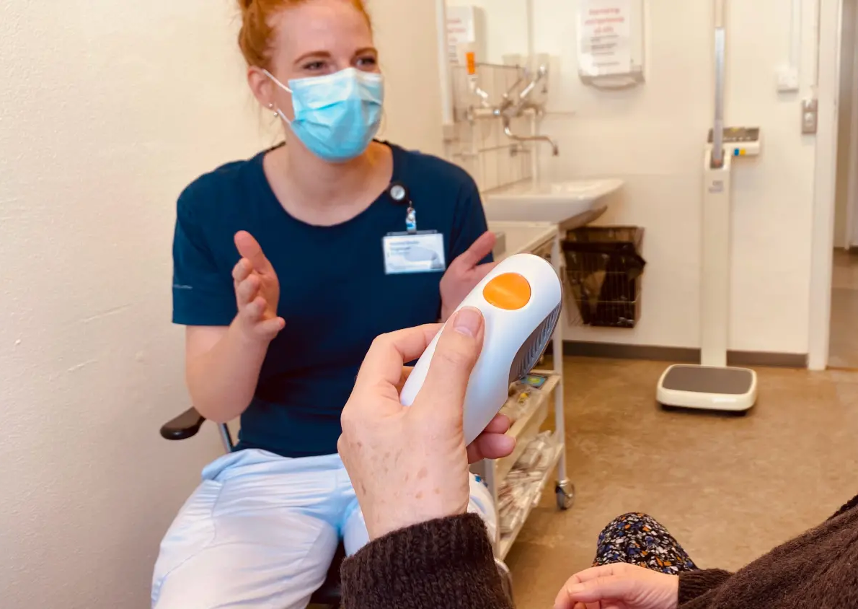
Status and experiences
Patients included: 267
Dropouts: 11
Patients are very satisfied with the solution
Hospital lab technicians are well-fitted for telemonitoring
Data are not shared with GP

Slide 20
Clinical implementation of an algorithm for predicting exacerbations in patients with COPD in telemonitoring

Slide 21
Sponsor and partners
Sponsor: The Danish Agency for Digitization has launched several signature projects in Denmark that seeks to investigate different perspectives of artificial intelligence
Partners: TeleCare North, Aalborg University, Aalborg Municipality, and Open Tele Health

Slide 22
Background
Prediction algorithms may improve the ability of telehealth solutions to assess the risk of future exacerbations in patients with chronic obstructive pulmonary disease (COPD)
More research is needed to further develop, test, and validate prediction algorithms to ensure that these algorithms improve outcomes before implementation in clinical practice

Slide 23
Trial objectives
To explore if inclusion of an algorithm in a telehealth-system can predict exacerbations and consequently reduce acute hospitalizations

Slide 24
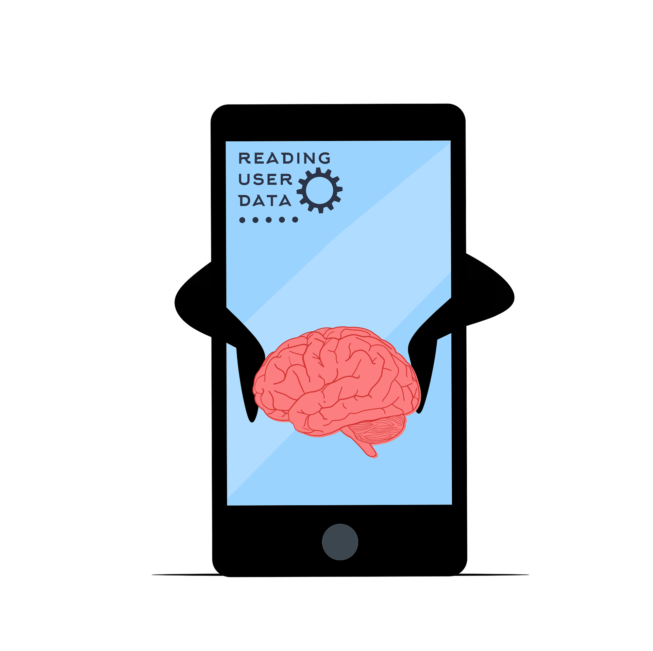
Trial design
Single-blinded Randomized controlled trial
Trial period: Six months
Patients with COPD using the TeleCare North Telehealth system
Telemonitoring with algoritm (intervention) was compared to usual care (control)
Notes:
The design is an open-label randomized controlled trial with a trial period of three months. Patients with T2D in telemonitoring (intervention) are compared with patients with T2D in usual care (control).

Slide 25
Identification and recruitment (n = 200)
Baseline measurement
Randomization
Control (n = 100)
Telehealth without algorithm
Measure vital signs as usual with two additional measurements
Intervention (n = 100)
Telehealth with algorithm
Measure vital signs as usual with two additional measurements
Follow-up at 6 months
Notes:
Interventionen kræver, at der foretages to ekstra saturationsmålinger ugentligt

Slide 26
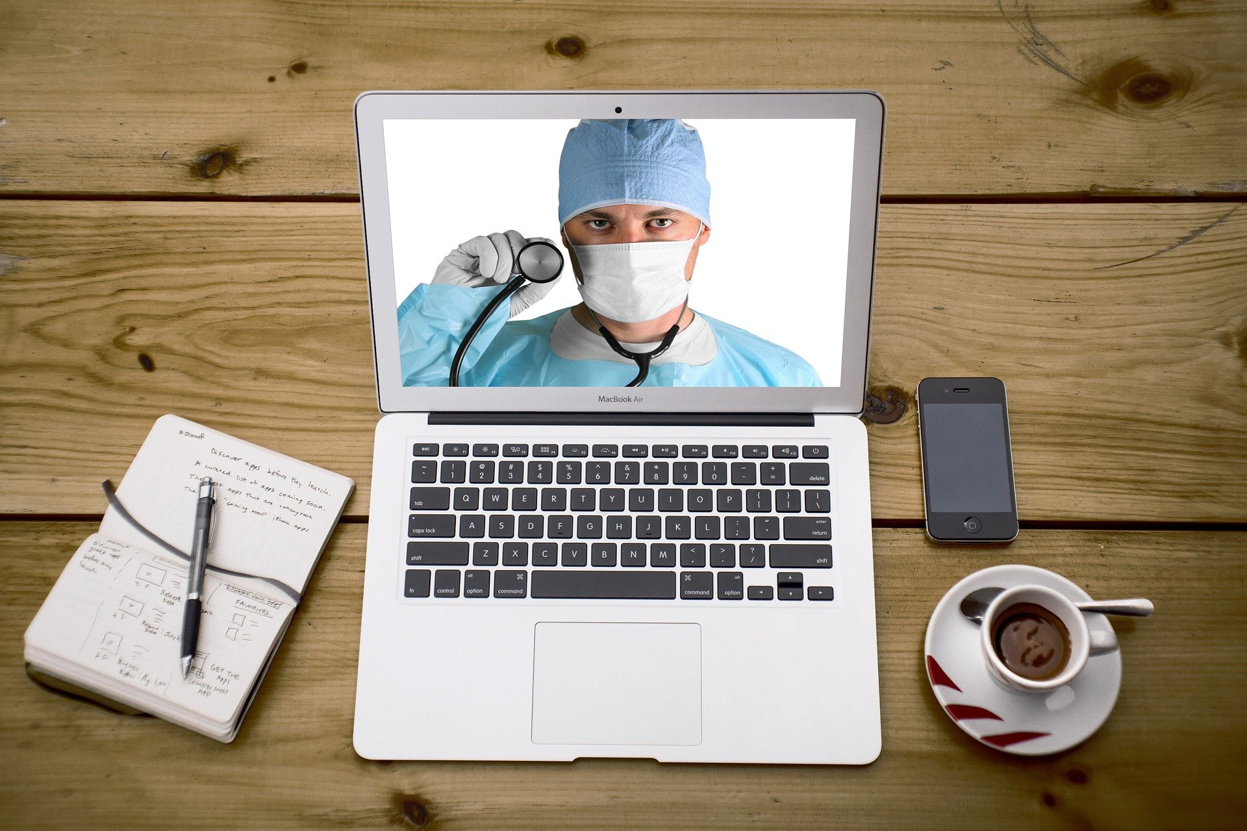
Status and experiences
FPLV: 30.11.2022
Data analysis is ongoing – first paper submitted
138 patients were included – 118 remained at follow-up after six months
The patients did not find it problematic to perform extra measurements
It is cruicial that the clinicians understand why the algorithm triggers an alarm

Slide 27
Stine Hangaard Casper
svh@hst.aau.dk

